Slide 1
The Spanish Life Sciences Trend Analysis 2019

Slide 2
About Us
The following statistical information has been obtained from Biotechgate. Biotechgate is a global, comprehensive, Life Sciences database encompassing the Biotechnology, Pharmaceutical and Medical Device industries. www.biotechgate.com
The Spanish Biotech Database is a part of the global Biotechgate and is brought to you in partnership with Biocat - BioRegió de Catalunya, the organization that champions the healthcare and life sciences ecosystem in Catalonia working to transform science and technology into regional economic growth as well as social impact. www.spanishbiotech.com
Biotechgate is owned and operated by Venture Valuation AG, a Zurich based company specializing in independent assessment and valuation of technology-driven companies in high growth industries, such as the Life Sciences (Biotech, Pharma, Medtech), ICT, high-tech, Nanotech, Cleantech and Renewable energy. www.venturevaluation.com

Slide 3
Overview of the Spanish Life-Science Industry
2019 Statistics
Total Biotech Companies | 542
Medtech Companies | 106
Pharma Companies | 94
Investor Companies | 43
Public / Non-Profit Organizations / Medical Facilities | 509
Other life science related companies | 750
Percentage of Publicly Owned Companies | 1.5%
Biotech Venture financing 2017/2018 | USD 33m/ 77m
Life Sciences Venture Financing 2017/2018 | USD 121m/ 75m
Number of Technologies | 159
Licensing Opportunities | 195

Slide 4
Overview of the Spanish Biotechnology Industry
2019 Statistics
Total Biotech companies | 542
Biotech - Therapeutics | 88
Biotech – R&D Services | 273
Biotech - Other | 181
Percentage of SMEs | 91%
Percentage of publicly owned companies | 1.5%
Biotech venture financing 2017/2018 | USD 33m/ 77m
Licensing opportunities | 120

Slide 5
Percentage of companies by ownership status

Slide 6
Company Foundation Timeline

Slide 7
Number of Biotechnology Companies by Key Activities

Slide 8
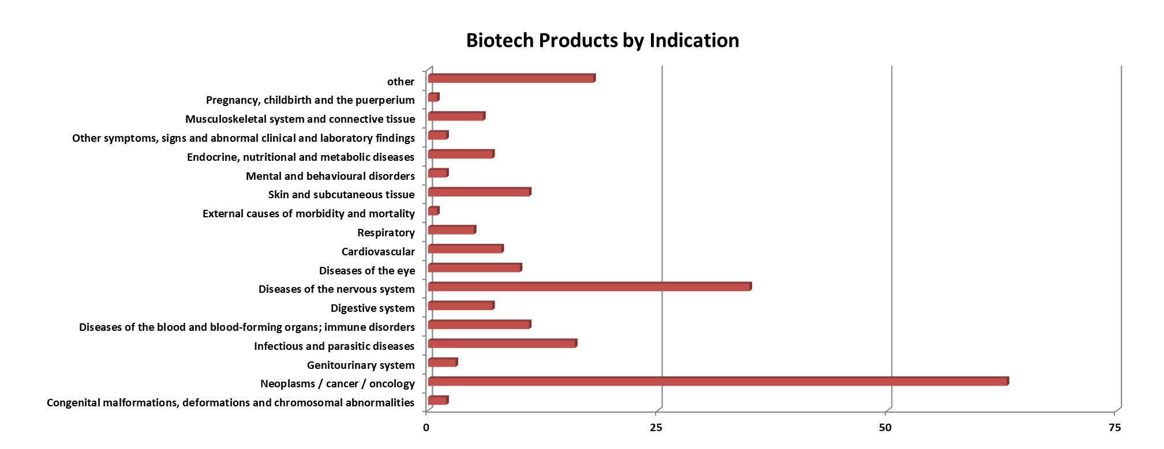
Biotech products - Breakdown by Indication

Slide 9
Products in the Pipeline

Slide 10
Biotechnology Financing in Spain – 5 year report

Slide 11
Major Biotech Financing Rounds (2018)
Company | Sector | USD M
Minoryx Therapeutics | Biotech – Therapeutics & Diagnostics | 25
ABAC Therapeutics | Biotech – Therapeutics & Diagnostics | 19.8
AlgaEnergy | Biotech – Other | 11.4

Slide 12
About Biotechgate
Biotechgate contains over 54,000 high quality company profiles which include company descriptions, contact information, product pipeline information, financing rounds and management details. Profiles are regularly updated by the companies themselves, as well as by an experienced database team, to ensure the accuracy and relevance of the data.
To register for a trial or to learn more about the different subscription options, please visit www.biotechgate.com.

Slide 13
Terms of Use
The ‘Spanish Life Sciences Trend Analysis’ is based on data entered in the Biotechgate Database available at www.biotechgate.com. The statistics and graphs in this presentation are based on figures and information entered in this database and we do not guarantee any accuracy hereof.
The use of the figures and graphs provided in this report is free of charge for any presentations as long as www.biotechgate.com is clearly cited as the source. For all other uses please contact us for terms and conditions. Biotechgate c/o Venture Valuation VV AG Kasernenstrasse 11
8004 Zurich
Switzerland
+41 (43) 321 86 60
www.venturevaluation.com

