Slide 1
UK Life Sciences Trend Analysis 2019

Slide 2
About Us
The following statistical information has been obtained from Biotechgate. Biotechgate is a global, comprehensive, Life Sciences database encompassing the Biotechnology, Pharmaceutical and Medical Device industries. www.biotechgate.com
The UK Life Sciences Database is a part of the global Biotechgate. Our UK partners include OBN and Life Sciences Hub Wales.
www.ukbiotech.com
Biotechgate is owned and operated by Venture Valuation AG, a Zurich-based company specializing in independent assessment and valuation of technology-driven companies in high growth industries, such as the Life Sciences (Biotech, Pharma, Medtech), ICT, high-tech, Nanotech, Cleantech and Renewable energy. www.venturevaluation.com

Slide 3
Overview of the UK Life-Science Industry
2019 Statistics
Total Biotech Companies | 1261
Medtech Companies | 325
Pharma Companies | 123
Investor Companies | 171
Public / Non-Profit Organizations / Medical Facilities | 480
Other life science related companies | 1618
Percentage of Publicly Owned Companies | 5.8 %
Biotech Venture financing 2018/2017 | USD 1778m / 1169m
Life Sciences Venture Financing 2018/2017 | USD 2171m / 1274m
Number of Technologies | 484
Licensing Opportunities | 386

Slide 4
Overview of the UK Biotechnology Industry
2019 Statistics
Total Biotech companies | 1261
Biotech - Therapeutics | 372
Biotech – R&D Services | 687
Biotech - Other | 202
Percentage of SMEs | 85%
Percentage of publicly owned companies | 5.8%
Biotech venture financing 2018/2017 | USD 1778m / 1169m
Licensing opportunities | 334

Slide 5
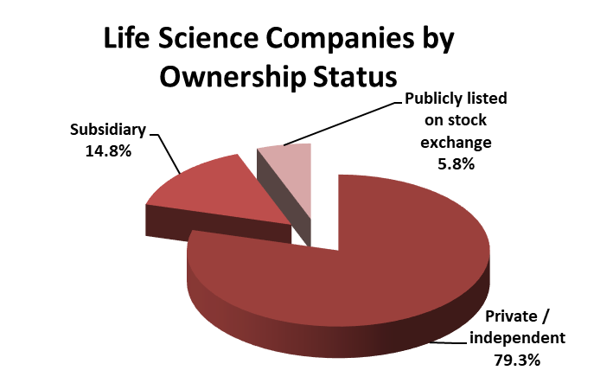
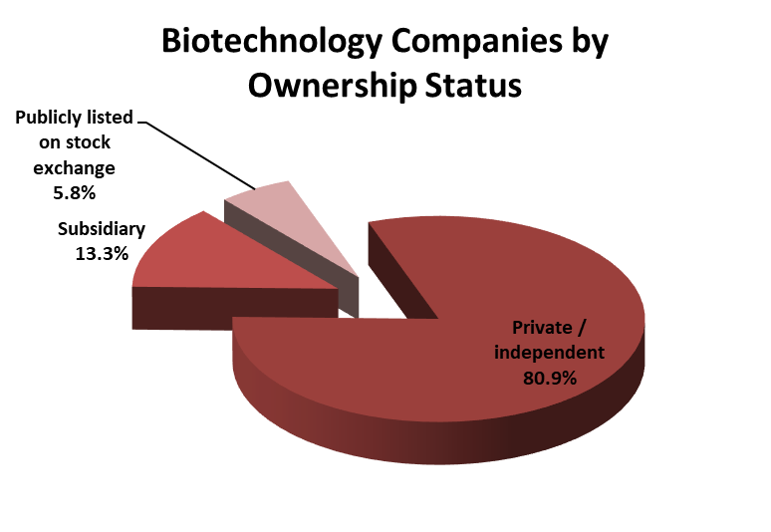
Percentage of companies by ownership status

Slide 6
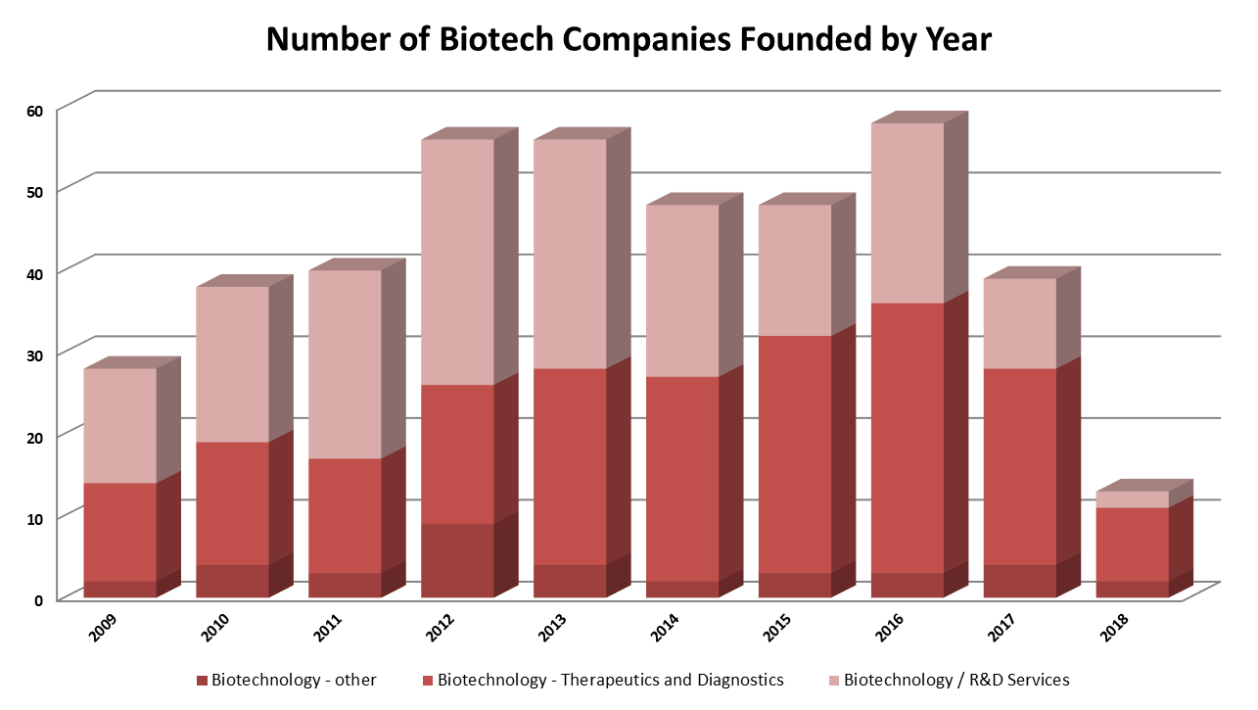
Company Foundation Timeline

Slide 7
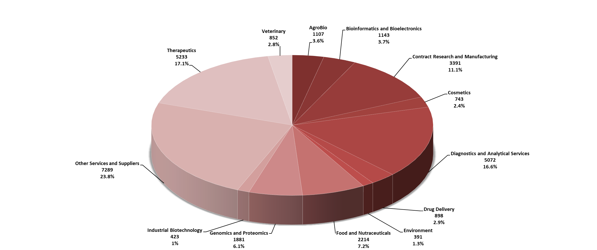
Number of Biotechnology Companies by Key Activities

Slide 8
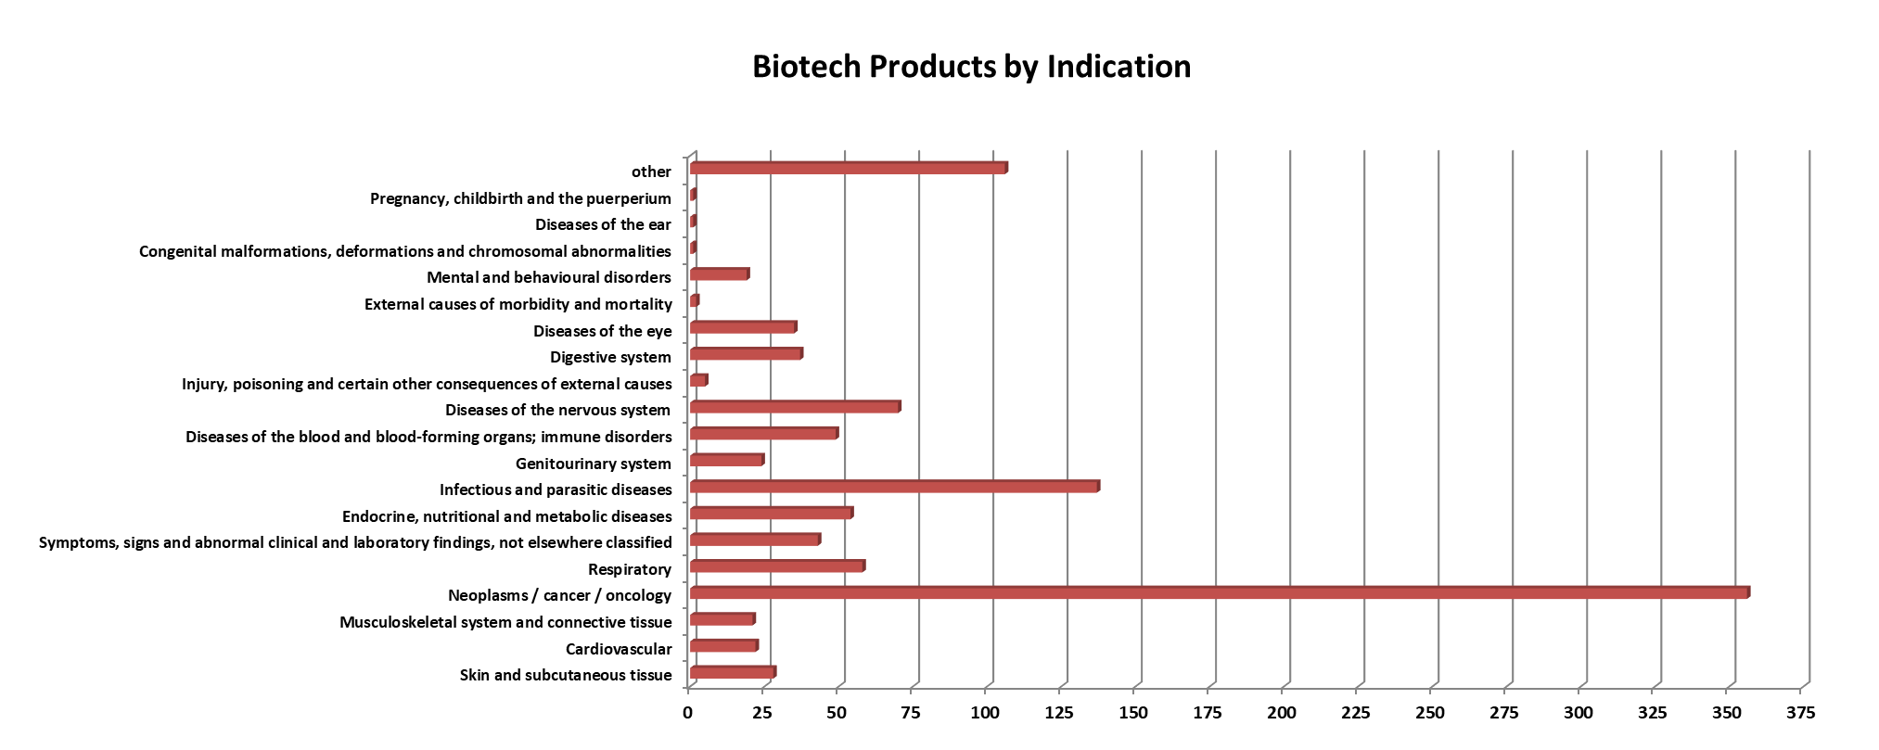
Biotech products - Breakdown by Indication

Slide 9
Products in the Pipeline

Slide 10
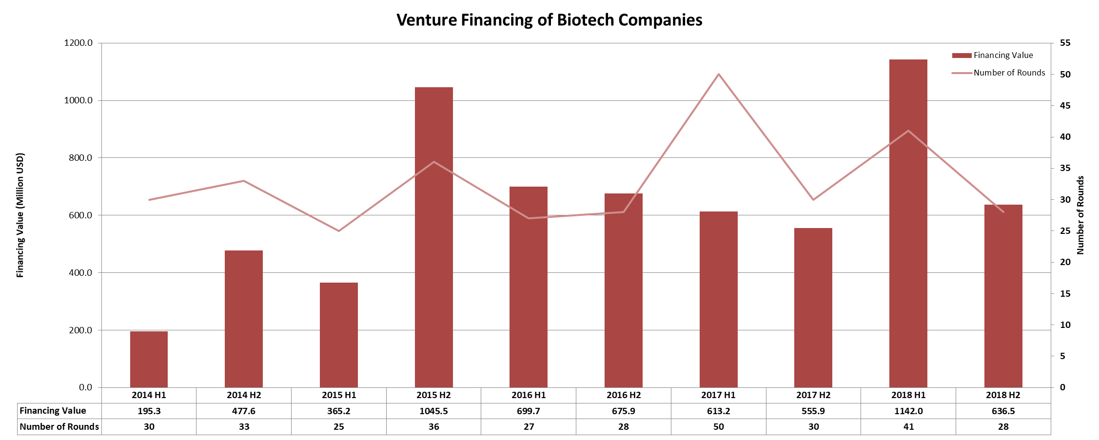
Biotechnology Financing in the UK– 5 year report

Slide 11
Major Biotech Financing Rounds (2018)
Company | Sector | USD M
Lift Biosciences | Biotech – Therapeutics & Diagnostics | 419
Orchard Therapeutics Ltd. | Biotech – Therapeutics & Diagnostics | 150
Oxford Nanopore Technologies | Biotechnology / R&D services | 140

Slide 12
About Biotechgate
Biotechgate contains over 54,000 high quality company profiles which include company descriptions, contact information, product pipeline information, financing rounds and management details. Profiles are regularly updated by the companies themselves, as well as by an experienced database team, to ensure the accuracy and relevance of the data.
To register for a trial or to learn more about the different subscription options, please visit www.biotechgate.com.

Slide 13
Terms of Use
The “UK Life Sciences Trend Analysis” is based on data entered in the Biotechgate Database available at www.biotechgate.com. The statistics and graphs in this presentation are based on figures and information entered in this database and we do not guarantee any accuracy hereof.
The use of the figures and graphs provided in this report is free of charge for any presentations as long as www.biotechgate.com is clearly cited as the source. For all other uses please contact us for terms and conditions. Biotechgate c/o Venture Valuation VV AG Kasernenstrasse 11
8004 Zurich
Switzerland
+41 (43) 321 86 60
www.venturevaluation.com

