Slide 1
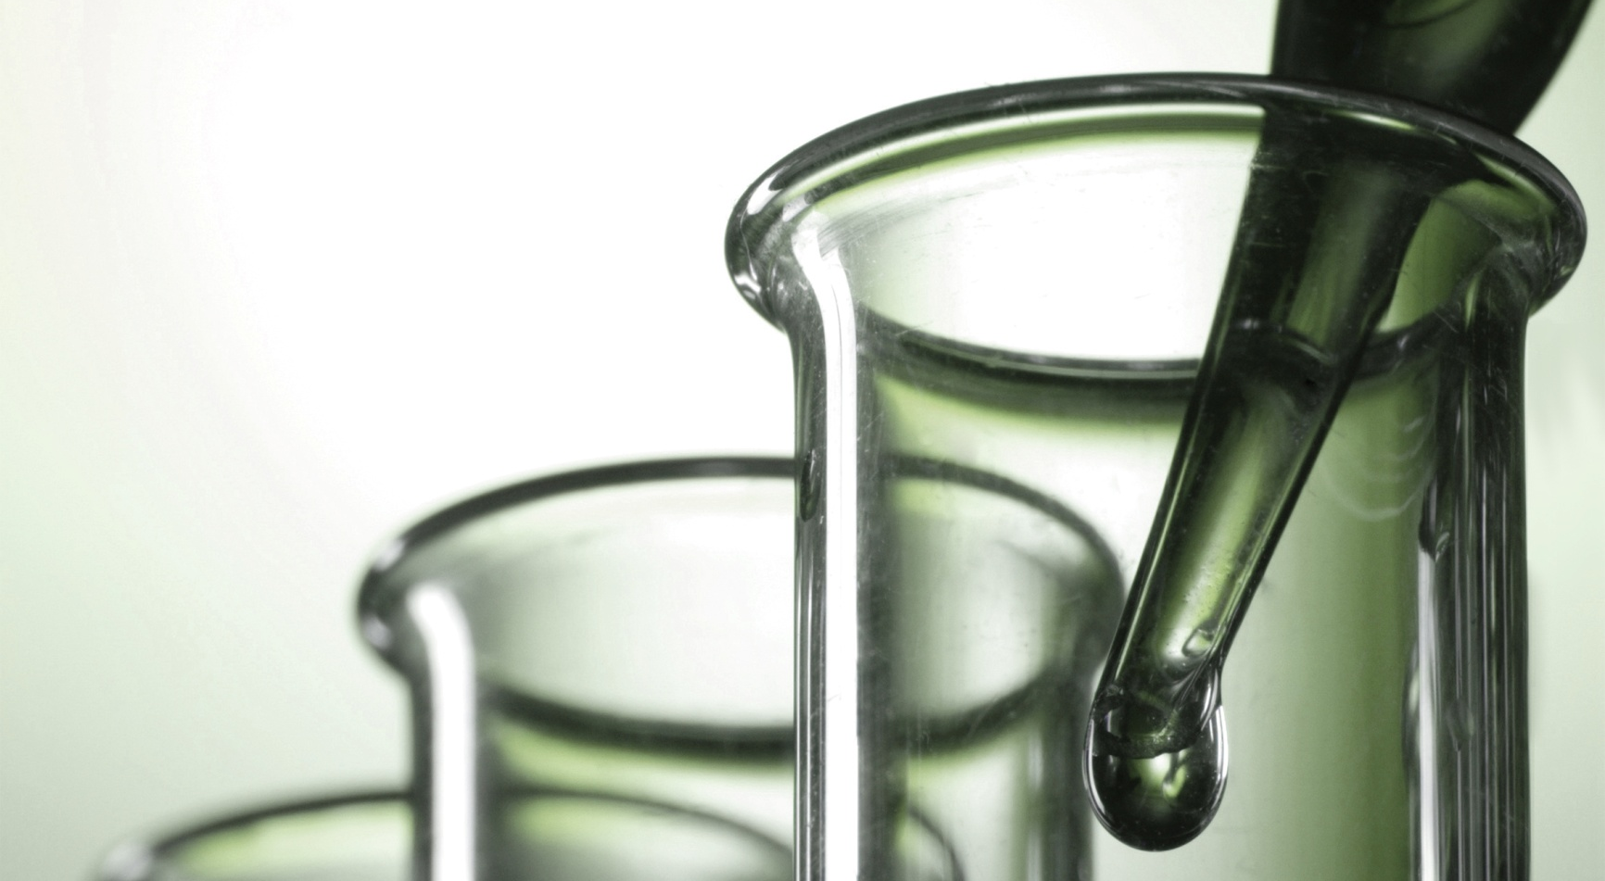
The Canadian Life Sciences Trend Analysis 2018

Slide 2
About Us
The following statistical information has been obtained from Biotechgate. Biotechgate is a global, comprehensive, Life Sciences database encompassing the Biotechnology, Pharmaceutical and Medical Device industries. www.biotechgate.com
The Canadian Life Sciences Database is a part of the global Biotechgate and is brought to you in partnership with BIOTECanada, TOHealth!, Life Sciences British Columbia, and BioAlberta. www.canadianlifesciences.com
Biotechgate is owned and operated by Venture Valuation AG, a Zurich based company specializing in independent assessment and valuation of technology-driven companies in high growth industries, such as the Life Sciences (Biotech, Pharma, Medtech), ICT, high-tech, Nanotech, Cleantech and Renewable energy. www.venturevaluation.com

Slide 3
Overview of the Canadian Life-Science Industry
2018 Statistics
Total Biotech Companies | 943
Medtech Companies | 367
Pharma Companies | 108
Investor Companies | 92
HealthTech | 222
Public / Non-Profit Organizations / Medical Facilities | 734
Other life science related companies | 1814
Percentage of Publicly Owned Companies | 9.4%
Life Sciences Venture Financing 2016 / 2017 / 2018 H1 | USD 364.4/ 831.7m/ 93.5m
Number of Technologies | 289
Licensing Opportunities | 241

Slide 4
Overview of the Canadian Biotechnology Industry
2018 Statistics
Total Biotech companies | 943
Biotech – Therapeutics and Diagnostics | 258
Biotech – R&D Services | 377
Biotech - Other | 309
Percentage of SMEs | 87%
Percentage of publicly owned companies | 11.1%
Biotech venture financing 2016 / 2017 / 2018 H1 | USD 336.1m / 721.5m / 92.6m
Licensing opportunities | 216

Slide 5
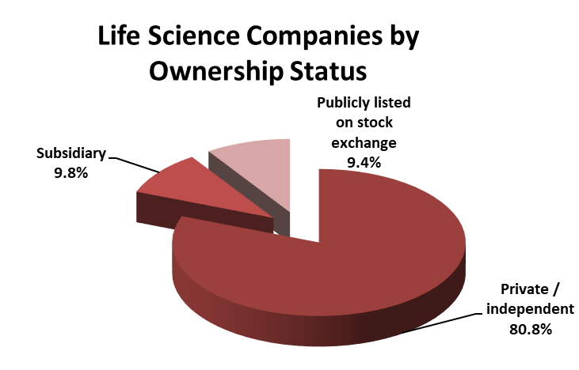
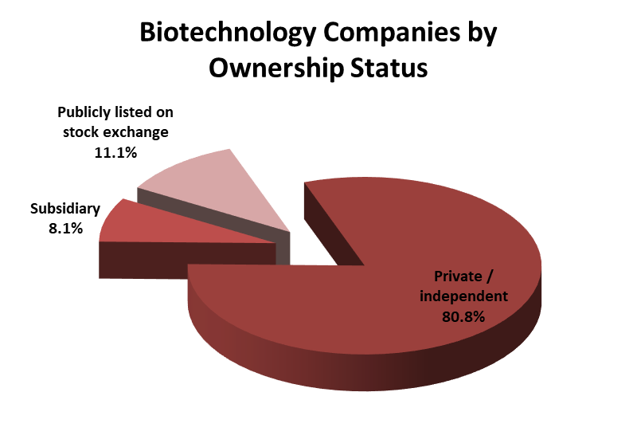
Number of companies by ownership status

Slide 6
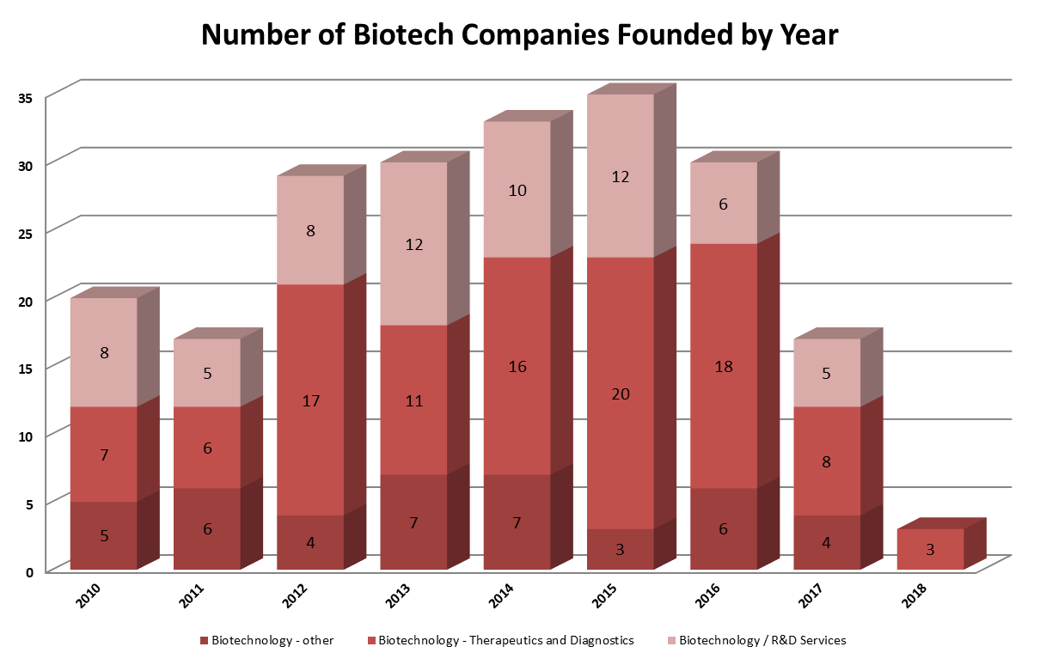
Company Foundation Timeline

Slide 7
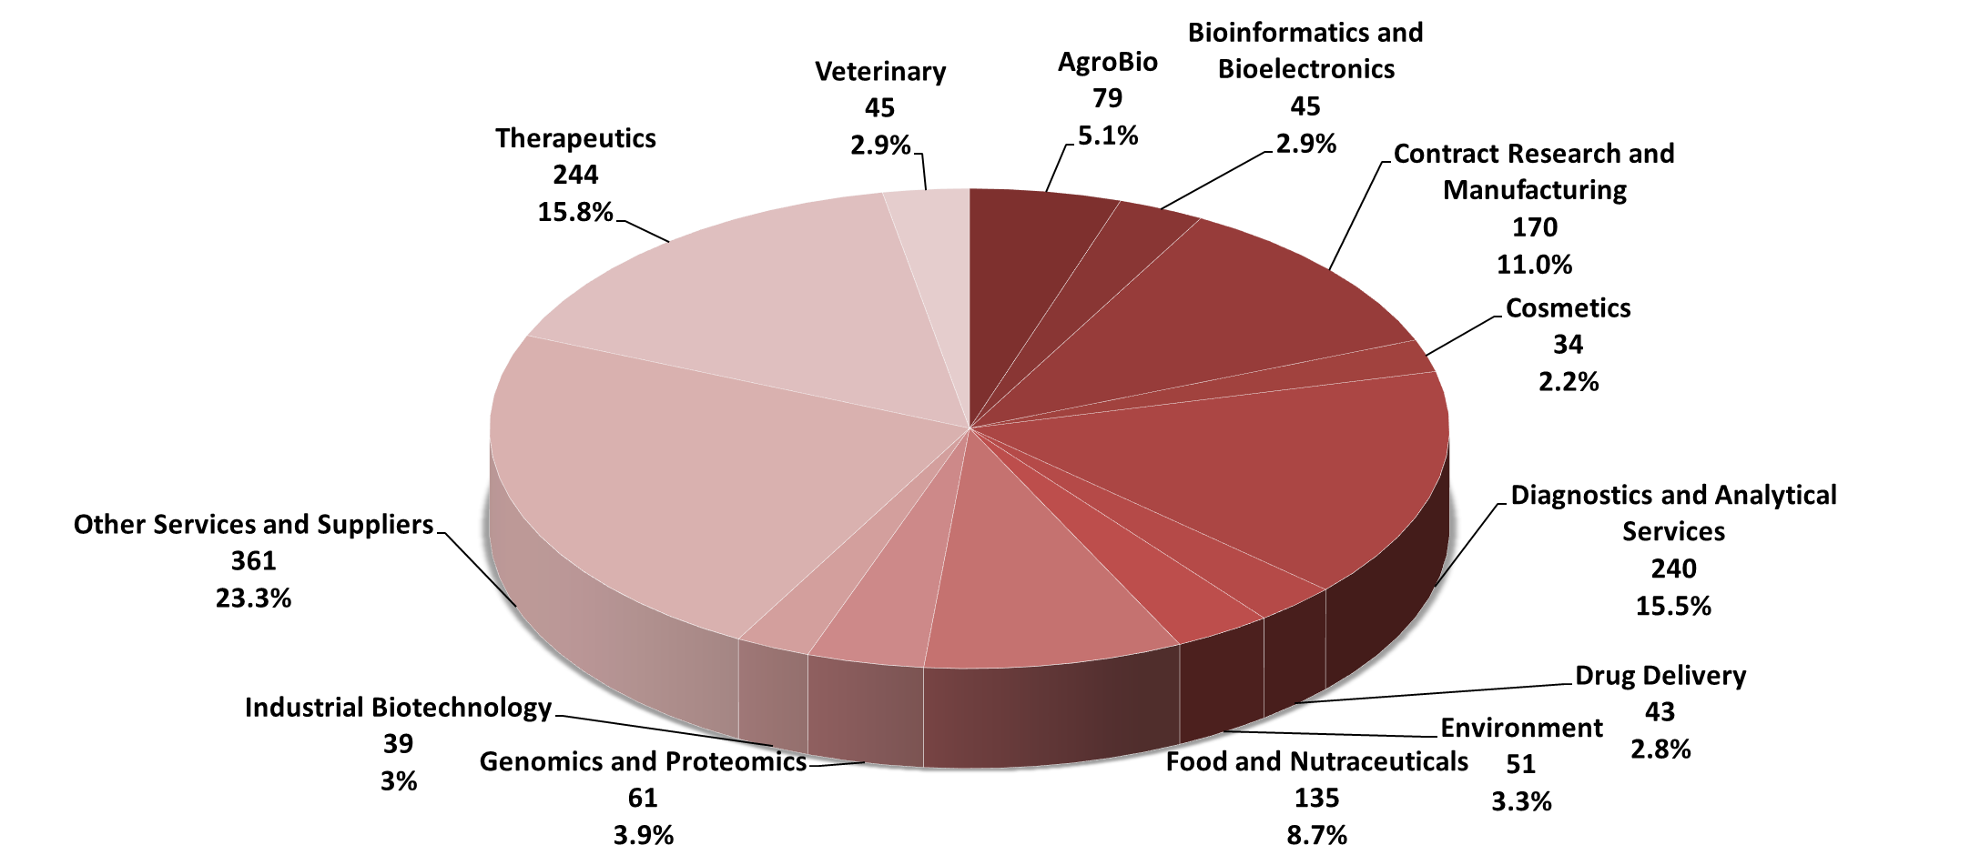
Number of Biotechnology Companies by Key Activities

Slide 8
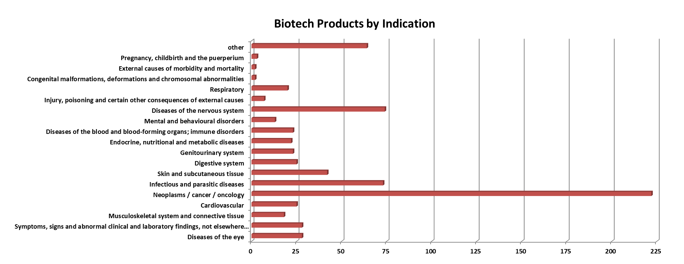
Biotech products - Breakdown by Indication

Slide 9
Products in the Pipeline

Slide 10
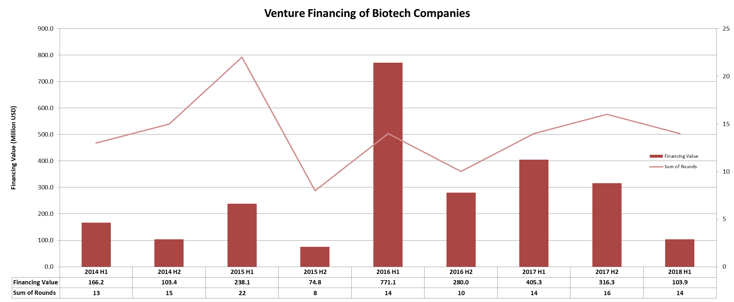
Biotechnology Financing in Canada – 5 year report

Slide 11
Major Biotech Financing Rounds (H1 2017 – H1 2018)
Company | Sector | USD M
Highland Therapeutics | Biotech – Therapeutics & Diagnostics | 200
Endoceutics | Biotech – Therapeutics & Diagnostics | 85
Repare Therapeutics | Biotech – Therapeutics & Diagnostics | 68

Slide 12
About Biotechgate
Biotechgate contains over 50,000 high quality company profiles which include company descriptions, contact information, product pipeline information, financing rounds and management details. Profiles are regularly updated by the companies themselves, as well as by an experienced database team, to ensure the accuracy and relevance of the data.
To register for a trial or to learn more about the different subscription options, please visit www.biotechgate.com.

Slide 13
Terms of Use
The ‘Canadian Life Sciences Trend Analysis’ is based on data entered in the Biotechgate Database available at www.biotechgate.com. The statistics and graphs in this presentation are based on figures and information entered in this database and we do not guarantee any accuracy hereof.
The use of the figures and graphs provided in this report is free of charge for any presentations as long as www.biotechgate.com is clearly cited as the source. For all other uses please contact us for terms and conditions. Biotechgate c/o Venture Valuation VV AG Kasernenstrasse 11
8004 Zurich
Switzerland
+41 (43) 321 86 60
www.venturevaluation.com

