Slide 1
The French Life Sciences Trend Analysis 2014

Slide 2
About Us
The following statistical information has been obtained from Biotechgate. Biotechgate is a global, comprehensive, Life Sciences database encompassing the Biotechnology,
Pharmaceutical and Medical Device industries. www.biotechgate.com
The French Biotech Database is a part of the global Biotechgate and is brought to you in partnership with APIM - the Lille Métropole Development Agency; assisting companies to establish and grow their Business in France from Lille.
www.frenchbiotech.com
Biotechgate is owned and operated by Venture Valuation AG, a Zurich based company specializing in independent assessment and valuation of technology-driven companies in high growth industries, such as the Life Sciences (Biotech, Pharma, Medtech), ICT, high-tech, Nanotech, Cleantech and Renewable energy. www.venturevaluation.com

Slide 3
Overview of the French Life-sciences Industry
2014 Statistics
Number of Biotech Companies | 625
Number of Medtech companies | 123
Number of Pharma companies | 67
Number of Investor companies | 25
Number of Public / Non-Profit Organizations / Medical Facilities | 537
Other Life sciences companies | 399
Percentage of Publicly Owned Companies | 4%
Venture Capital Raised (2013) | USD 274m
Venture Capital Raised (2012) | USD 172m
Number of Technologies | 228
Licensing Opportunities | 278

Slide 4
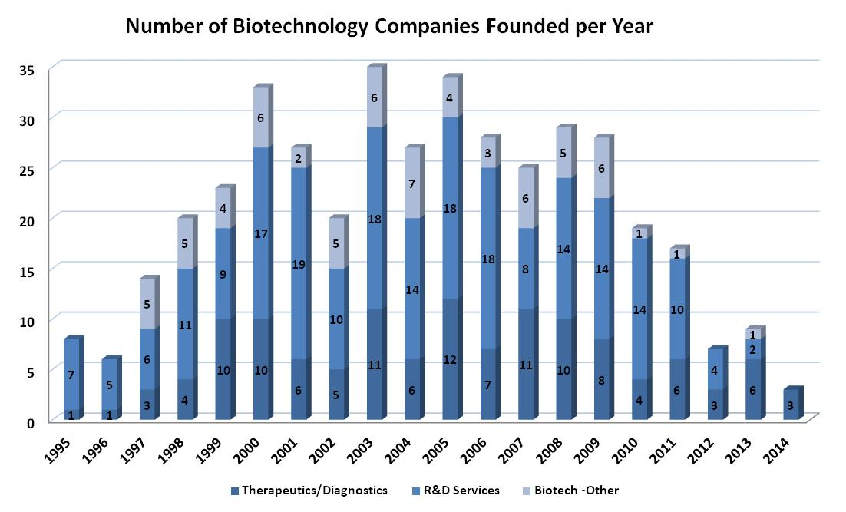
Company Foundation Timeline

Slide 5
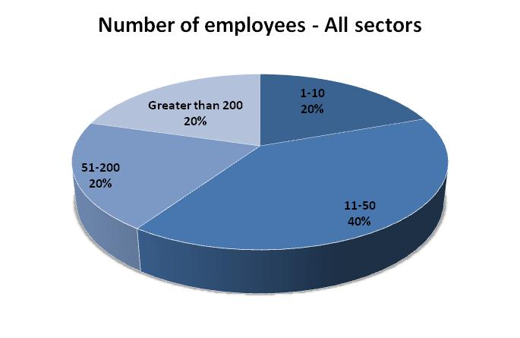
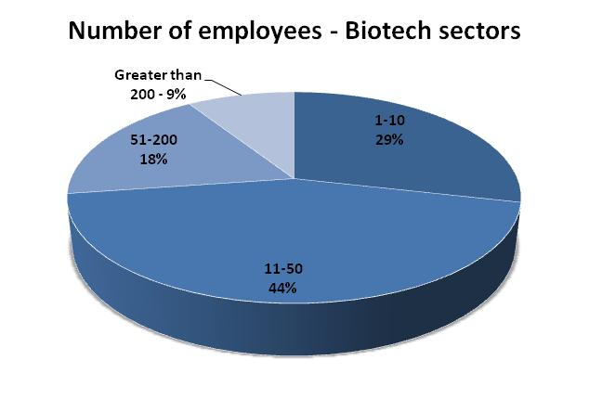
Number of Employees

Slide 6
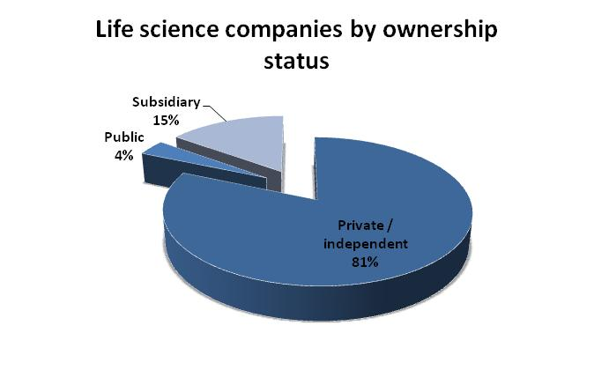
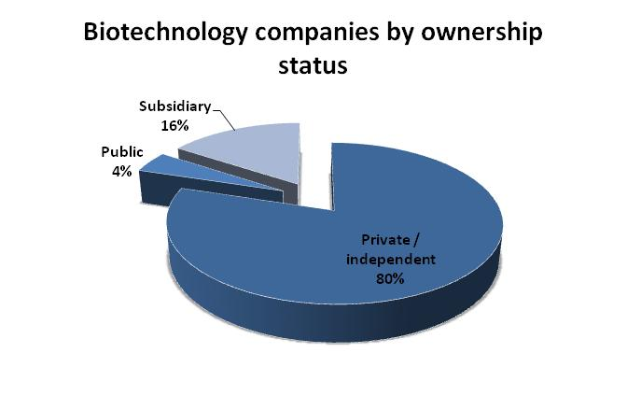
Company Ownership

Slide 7
Overview of the French Biotech Industry
2013 Statistics |  | 2014 Statistics
685 | Total Biotech Companies | 625
159 | Biotech - Therapeutics | 123
349 | Biotech - R&D Services | 335
177 | Biotech - Other | 167
3 (2012) | Number of IPOs | 1 (2013)
4% | Percentage of Publicly Owned Companies | 4%
USD 151m (2012) | Venture Capital Raised | USD 197m (2013)
685 | Licensing Opportunities | 278

Slide 8
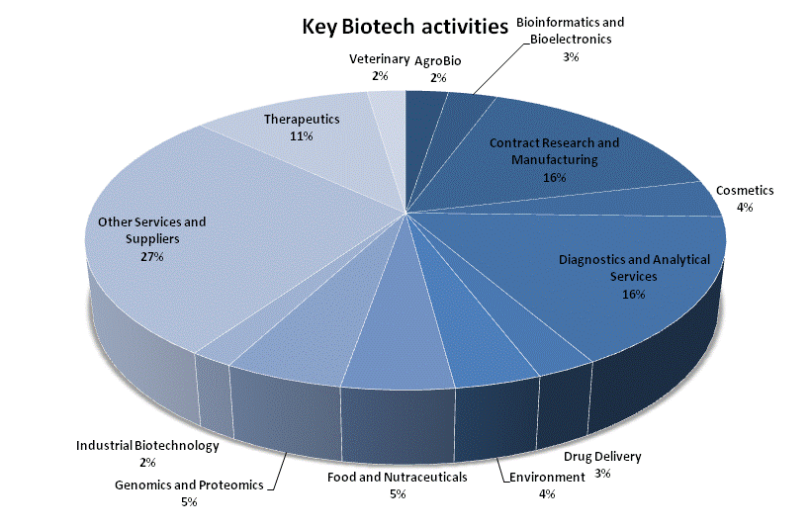
Key Activities of Biotechnology Companies

Slide 9
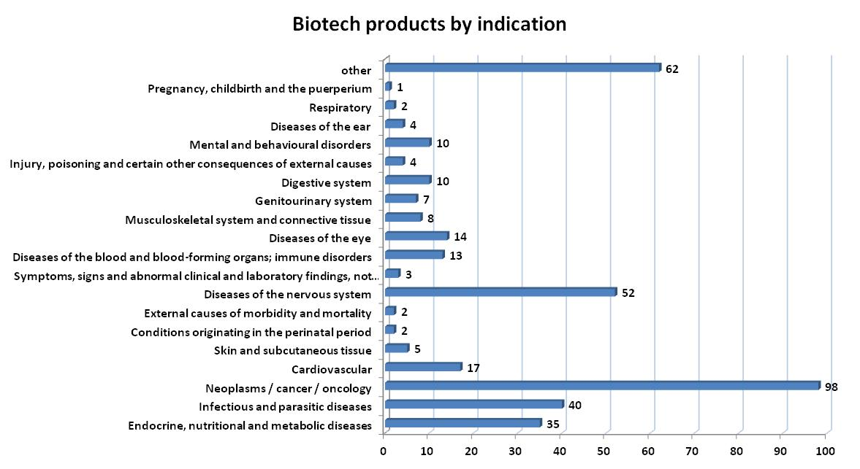
Biotech products - Breakdown by Indication

Slide 10
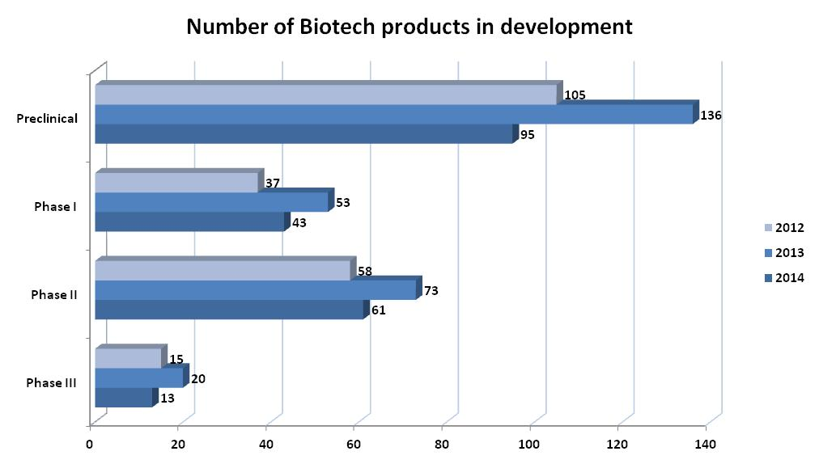
Products in the Pipeline - Three-year trend

Slide 11
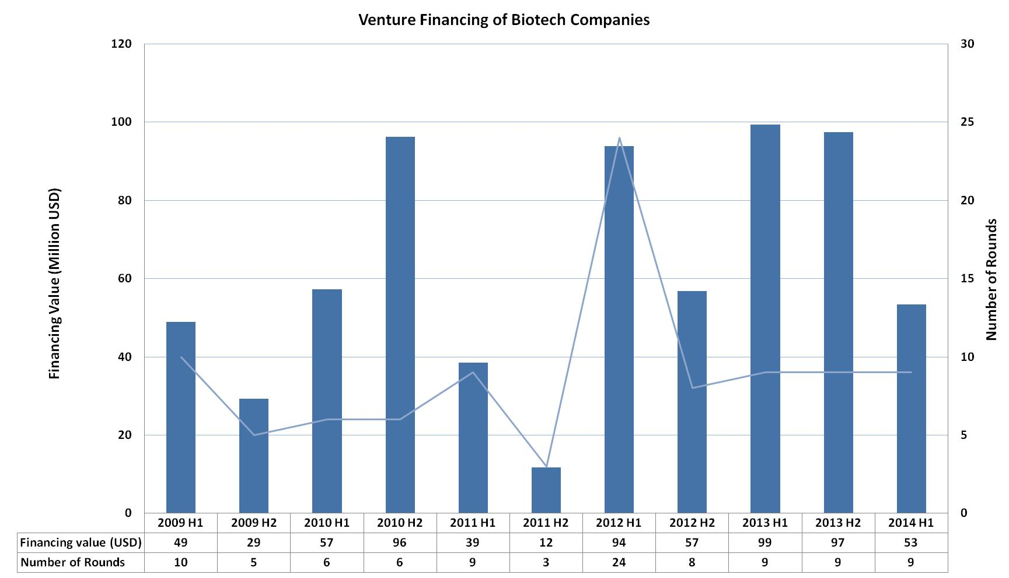
Venture Biotech Financing in France - Half-yearly Data

Slide 12
Major Financing Rounds (H2 2013 – H1 2014)
Company | Sector | USD M
Global Bioenergies SA | Biotechnology - other | 49.6
Lysogene | Biotech – Therapeutics & Diagnostics | 22.7
THERAVECTYS SA | Biotech – Therapeutics & Diagnostics | 20
AAVLife | Biotech – Therapeutics & Diagnostics | 12
Enterome | Biotechnology - R&D Services | 10

Slide 13
About Biotechgate
Biotechgate contains over 30’000 high quality company profiles which include company descriptions, contact information, product pipeline information, financing rounds and management details. Profiles are regularly updated by the companies themselves, as well as by an experienced database team, to ensure the accuracy and relevance of the data.
To register for free or learn more about the different subscription options, please visit www.biotechgate.com.

Slide 14
Terms of Use
The “French Life Sciences Trend Analysis” is based on data entered in the Biotechgate Database available at www.biotechgate.com. The statistics and graphs in this presentation are based on figures and information entered in this database and we do not guarantee any accuracy hereof.
The use of the figures and graphs provided in this report is free of charge for any presentations as long as www.biotechgate.com is clearly cited as the source. For all other uses please contact us for terms and conditions. Biotechgate c/o Venture Valuation VV AG Kasernenstrasse 11 +41 (43) 321 86 60
8004 Zurich info@venturevaluation.com
Switzerland www.venturevaluation.com

