Slide 1
The Spanish Life-Sciences Trend Analysis 2014

Slide 2
About Us
The following statistical information has been obtained from Biotechgate. Biotechgate is a global, comprehensive, Life Sciences database encompassing the Biotechnology, Pharmaceutical and Medical Device industries. www.biotechgate.com
The Spanish Biotech Database is a part of the global Biotechgate and is brought to you in partnership with Biocat - BioRegió de Catalunya; the organization that coordinates and promotes the life sciences sector in Catalonia. www.spanishbiotech.com
Biotechgate is owned and operated by Venture Valuation AG, a Zurich based company specializing in independent assessment and valuation of technology-driven companies in high growth industries, such as the Life Sciences (Biotech, Pharma, Medtech), ICT, high-tech, Nanotech, Cleantech and Renewable energy. www.venturevaluation.com

Slide 3
Overview of the Spanish Life-sciences Industry
2014 Statistics
Total Biotech Companies | 379
Medtech companies | 62
Pharma companies | 62
Investor companies | 25
Public / Non-Profit Organizations / Medical Facilities | 449
Other Life sciences companies | 297
Percentage of Publicly Owned Companies | 2%
Venture Capital Raised (2013) | USD 30m
Venture Capital Raised (2012) | USD 27m
Number of technologies | 188
Licensing Opportunities | 278

Slide 4
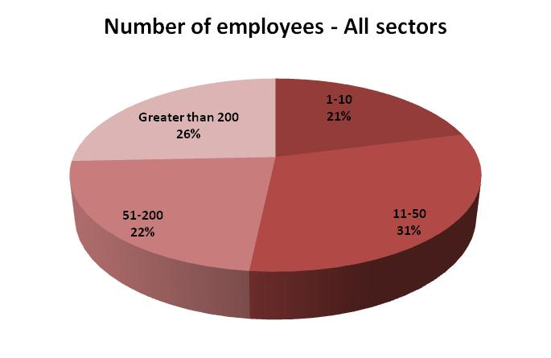
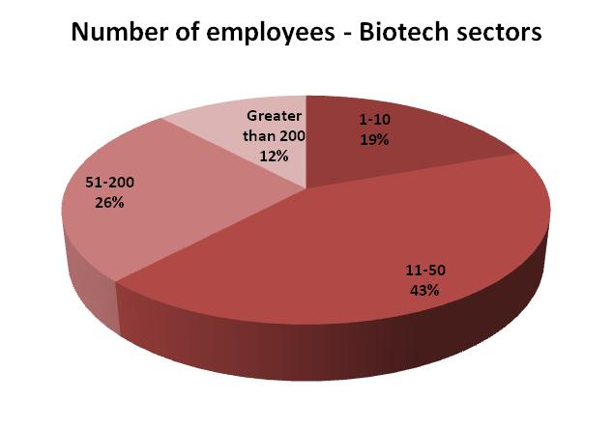
Number of Employees

Slide 5
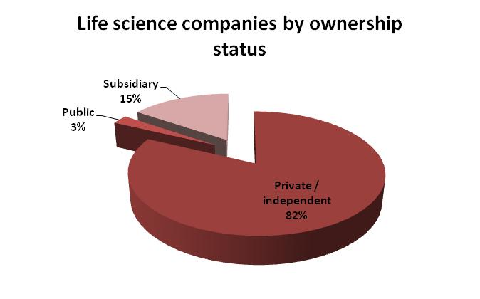
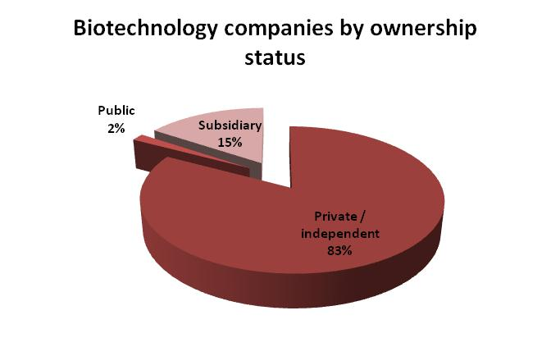
Company Ownership

Slide 6
Overview of the Spanish Biotech Industry
2014 Statistics
Total Biotech Companies | 379
Biotech - Therapeutics | 78
Biotech - R&D Services | 185
Biotech - Other | 116
Number of Initial Public offerings (2013) | 0
Percentage of Publicly Owned Companies | 2%
Venture Capital Raised (2013) | USD 30m
Venture Capital Raised (2012) | USD 27m
Licensing Opportunities | 188

Slide 7
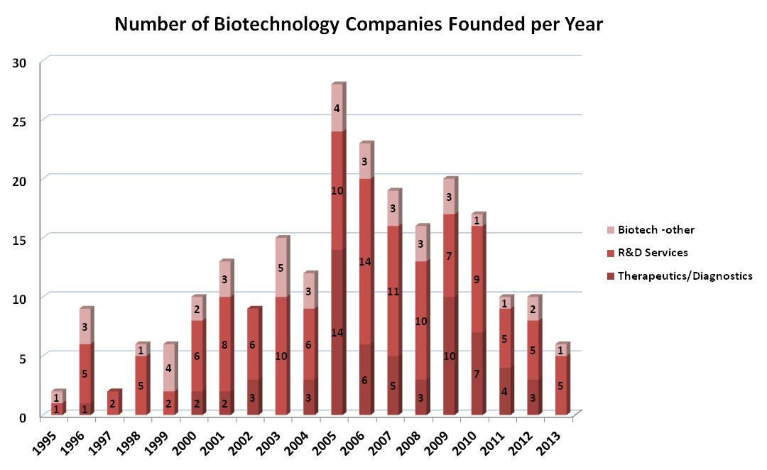
Company Foundation Timeline

Slide 8
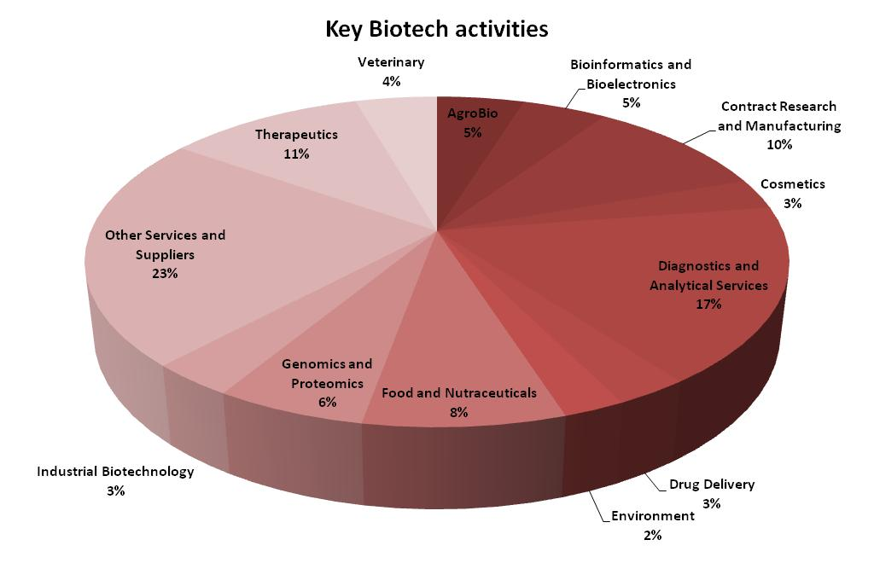
Key Activities of Biotechnology Companies

Slide 9
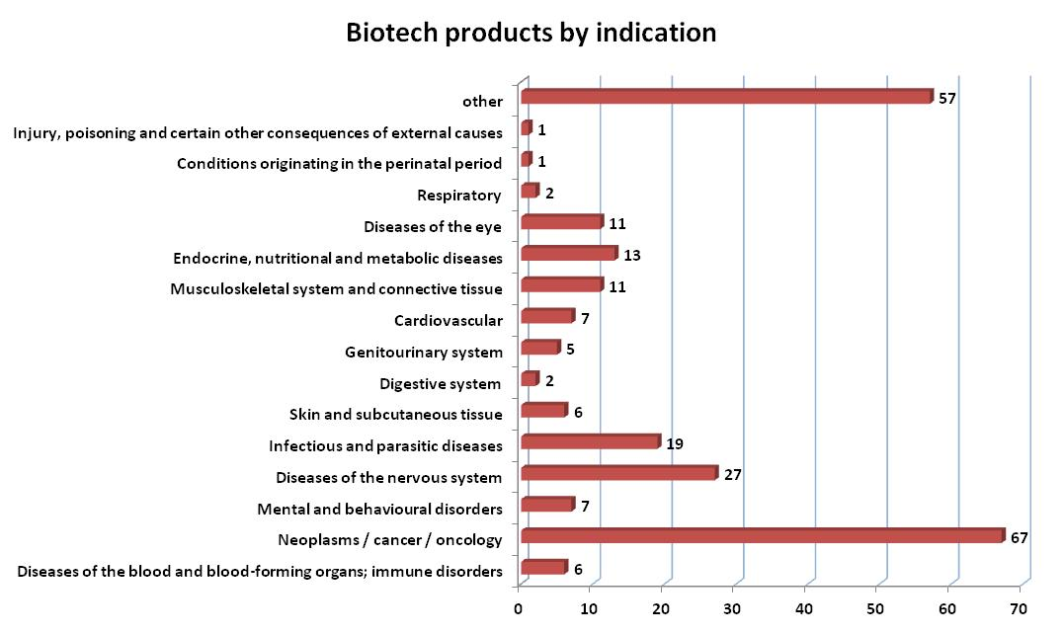
Biotech Products by Indication

Slide 10
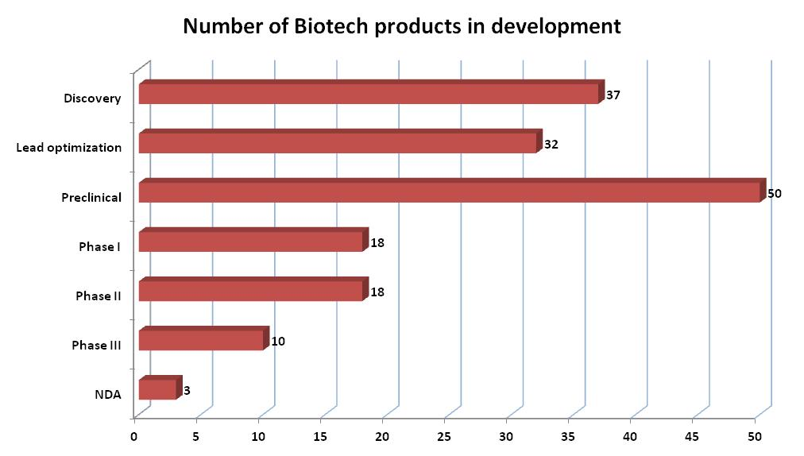
Biotech Pipeline breakdown by stage - 2014

Slide 11
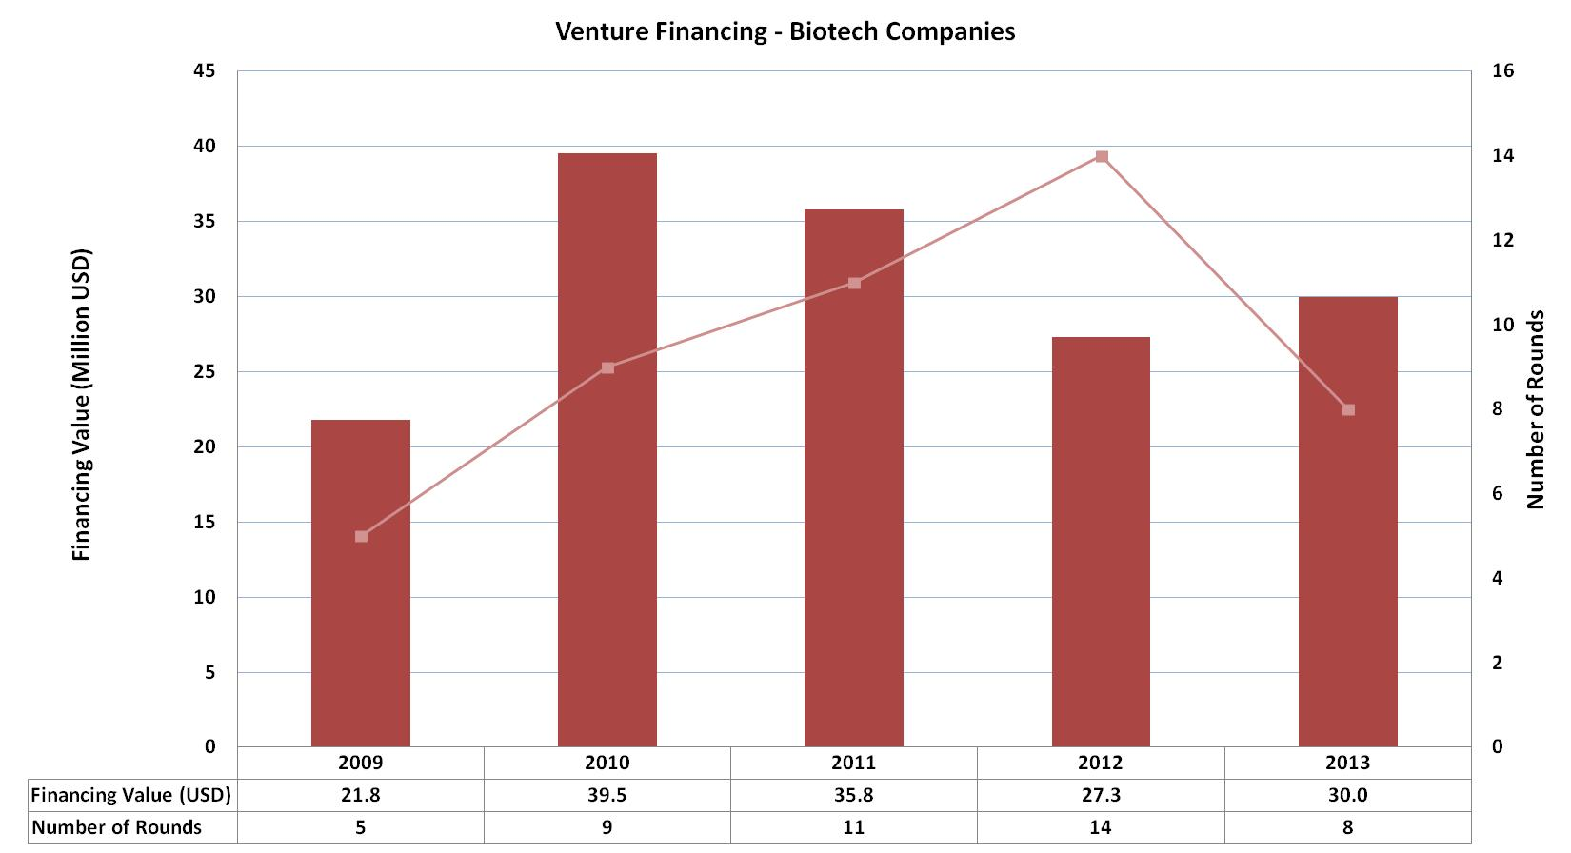
Venture Financing in Spain

Slide 12
Major Financing Rounds (2013)
Company | Sector | USD M
STAT-Diagnostica & Innovation | Biotech – Therapeutics & Diagnostics | 22.1
Palobiofarma S.L | Biotech – Therapeutics & Diagnostics | 5.9
Minoryx Therapeutics | Biotech – Therapeutics & Diagnostics | 2

Slide 13
About Biotechgate
Biotechgate contains over 30’000 high quality company profiles which include company descriptions, contact information, product pipeline information, financing rounds and management details. Profiles are regularly updated by the companies themselves, as well as by an experienced database team, to ensure the accuracy and relevance of the data.
To register for free or learn more about the different subscription options, please visit www.biotechgate.com.

Slide 14
Terms of Use
The “Spanish Life Sciences Trend Analysis” is based on data entered in the Biotechgate Database available at www.biotechgate.com. The statistics and graphs in this presentation are based on figures and information entered in this database and we do not guarantee any accuracy hereof.
The use of the figures and graphs provided in this report is free of charge for any presentations as long as www.biotechgate.com is clearly cited as the source. For all other uses please contact us for terms and conditions. Biotechgate c/o Venture Valuation VV AG Kasernenstrasse 11 +41 (43) 321 86 60
8004 Zurich info@venturevaluation.com
Switzerland www.venturevaluation.com

